Slide 1
The Network Layer
Chapter 5

Slide 2
Network Layer Design Issues
Store-and-Forward Packet Switching
Services Provided to the Transport Layer
Implementation of Connectionless Service
Implementation of Connection-Oriented Service
Comparison of Virtual-Circuit and Datagram Subnets

Slide 3

Store-and-Forward Packet Switching
fig 5-1
The environment of the network layer protocols.

Slide 4

Implementation of Connectionless Service
Routing within a diagram subnet.

Slide 5

Implementation of Connection-Oriented Service
Routing within a virtual-circuit subnet.

Slide 6

Comparison of Virtual-Circuit and Datagram Subnets
5-4

Slide 7
Internetworking
How Networks Differ
How Networks Can Be Connected
Concatenated Virtual Circuits
Connectionless Internetworking
Tunneling
Internetwork Routing
Fragmentation

Slide 8
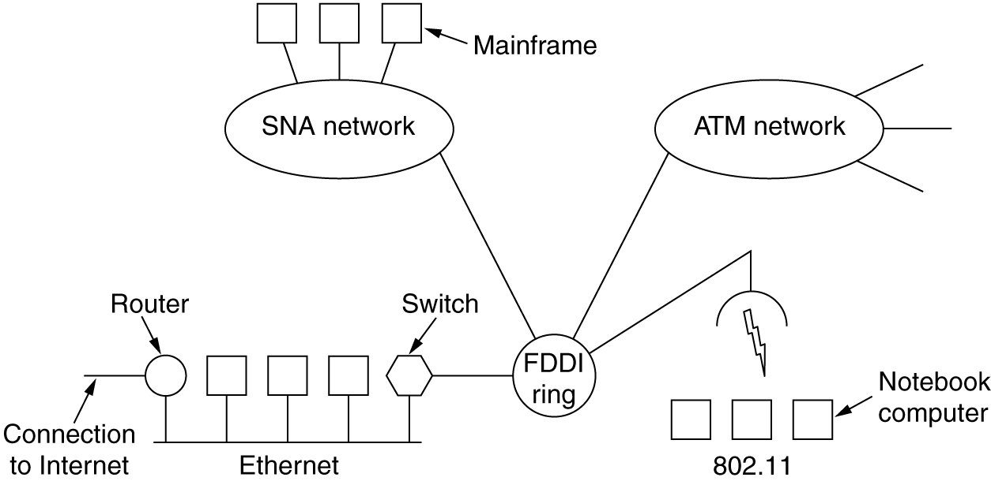
Connecting Networks
A collection of interconnected networks.

Slide 9
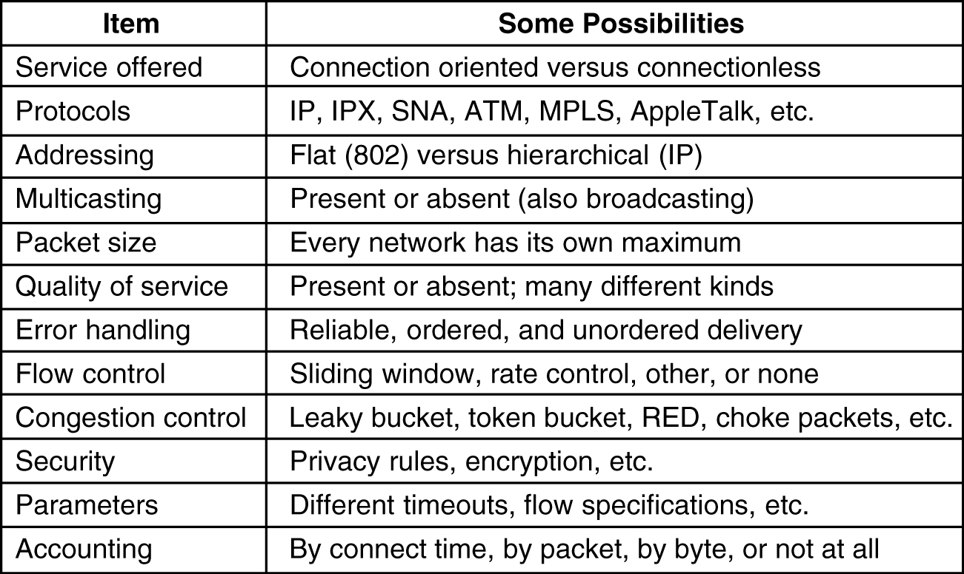
How Networks Differ
5-43
Some of the many ways networks can differ.

Slide 10
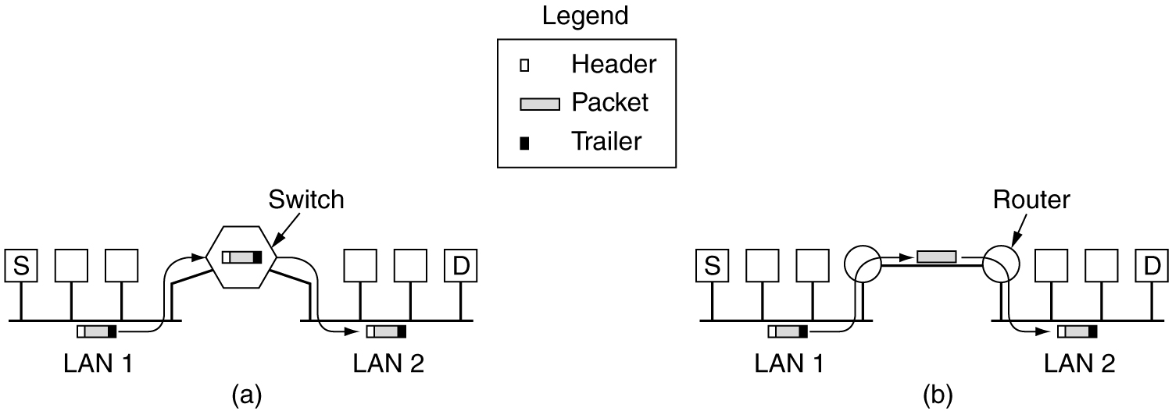
How Networks Can Be Connected
(a) Two Ethernets connected by a switch.
(b) Two Ethernets connected by routers.

Slide 11
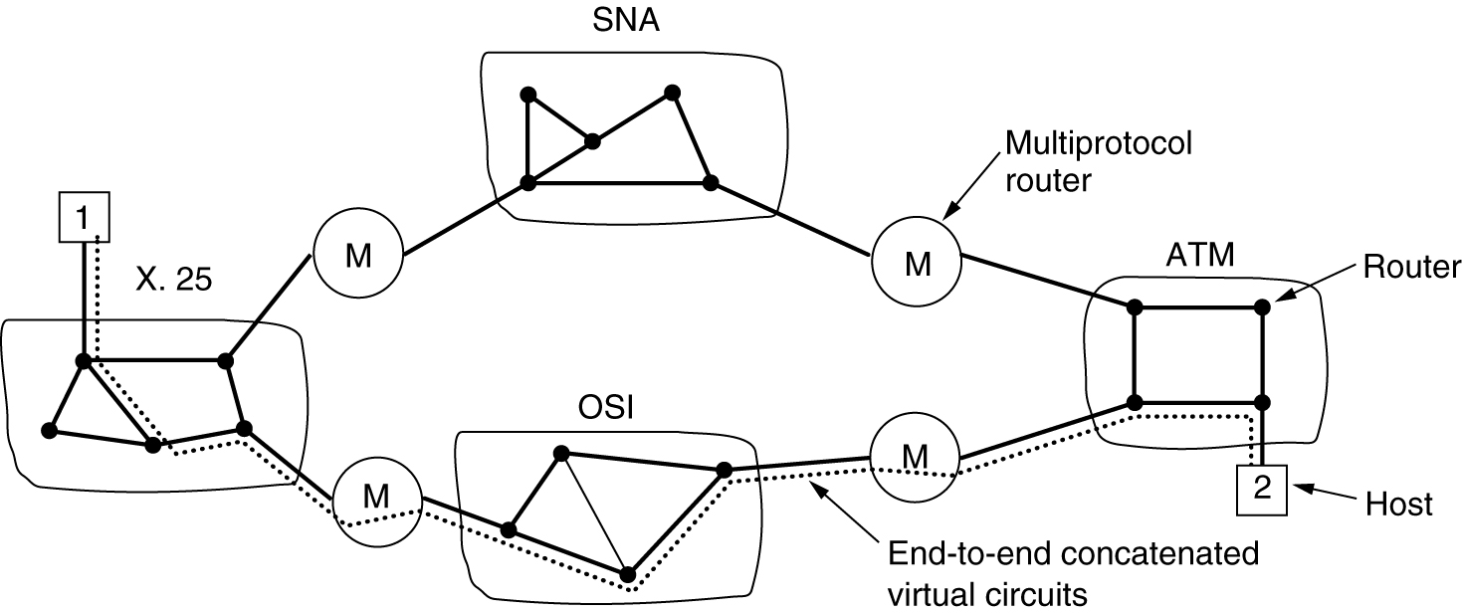
Concatenated Virtual Circuits
Internetworking using concatenated virtual circuits.

Slide 12
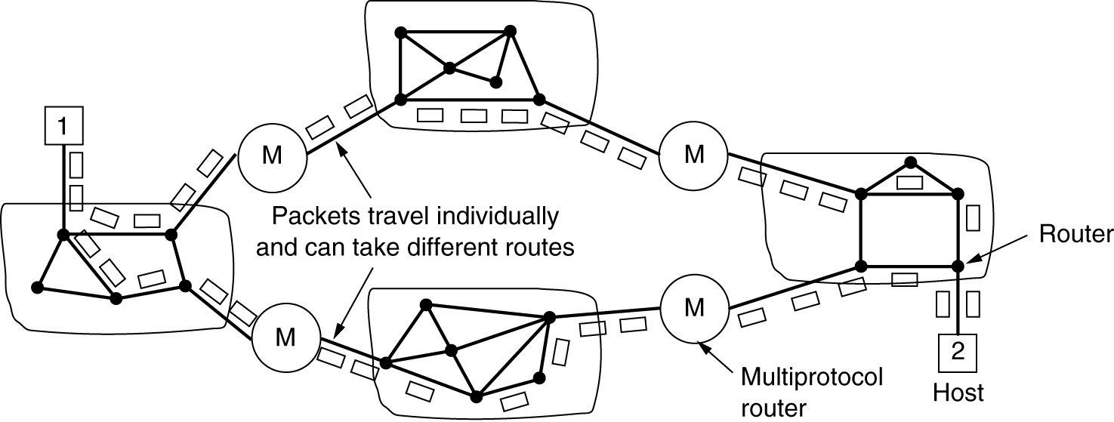
Connectionless Internetworking
A connectionless internet.

Slide 13
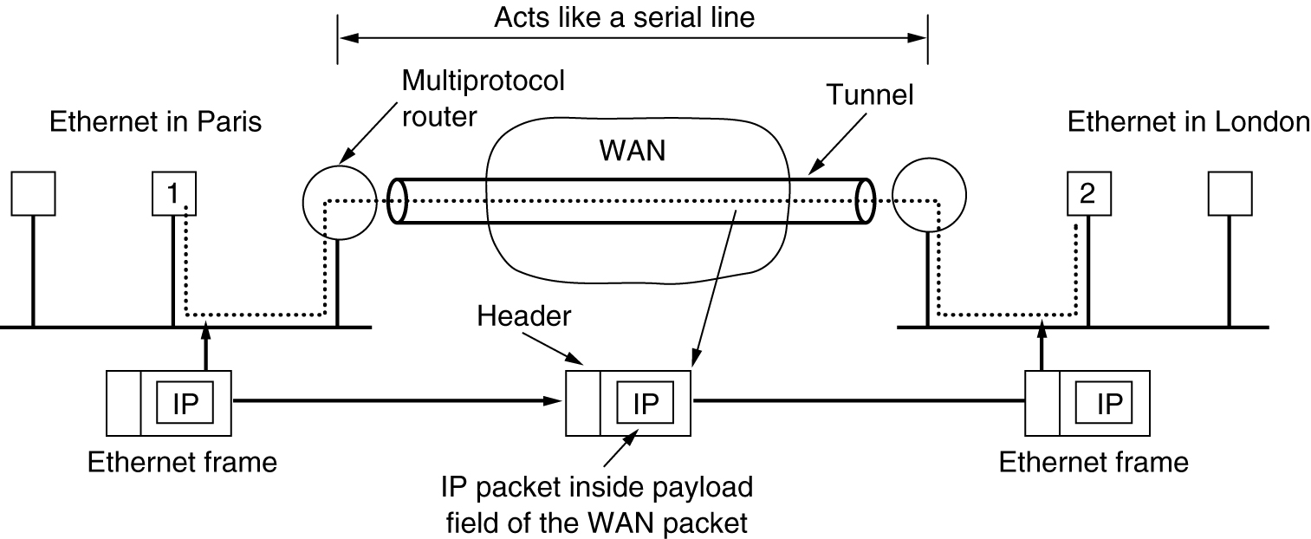
Tunneling
Tunneling a packet from Paris to London.

Slide 14
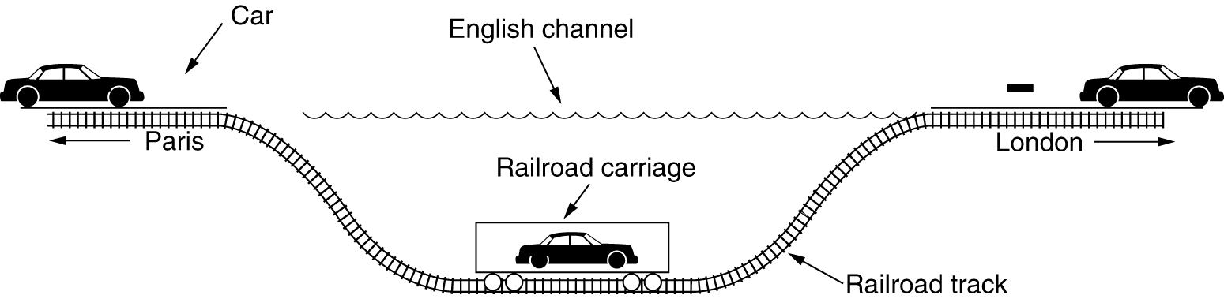
Tunneling (2)
Tunneling a car from France to England.

Slide 15
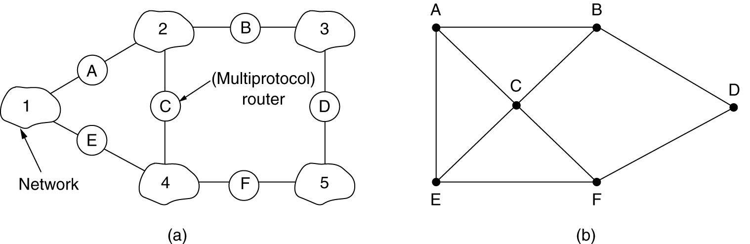
Internetwork Routing
(a) An internetwork. (b) A graph of the internetwork.

Slide 16
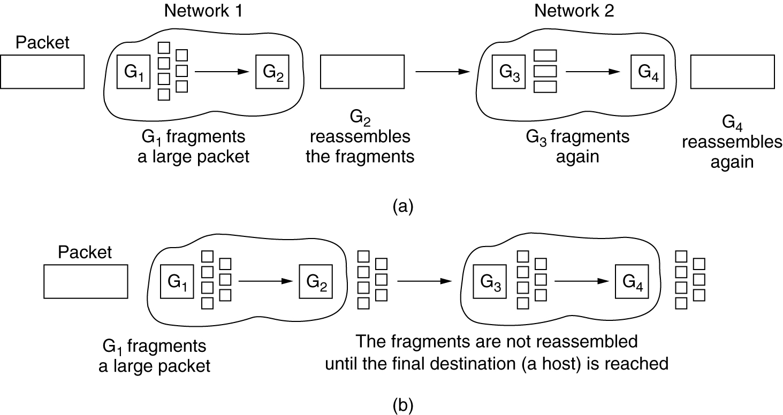
Fragmentation
(a) Transparent fragmentation. (b) Nontransparent fragmentation.

Slide 17
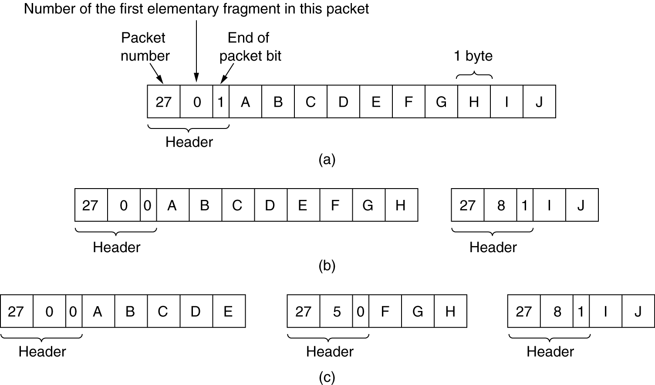
Fragmentation (2)
Fragmentation when the elementary data size is 1 byte.
(a) Original packet, containing 10 data bytes.
(b) Fragments after passing through a network with maximum packet size of 8 payload bytes plus header.
(c) Fragments after passing through a size 5 gateway.

Slide 18
The Network Layer in the Internet
The IP Protocol
IP Addresses
Internet Control Protocols
OSPF – The Interior Gateway Routing Protocol
BGP – The Exterior Gateway Routing Protocol
Internet Multicasting
Mobile IP
IPv6

Slide 19
Design Principles for Internet
Make sure it works.
Keep it simple.
Make clear choices.
Exploit modularity.
Expect heterogeneity.
Avoid static options and parameters.
Look for a good design; it need not be perfect.
Be strict when sending and tolerant when receiving.
Think about scalability.
Consider performance and cost.

Slide 20
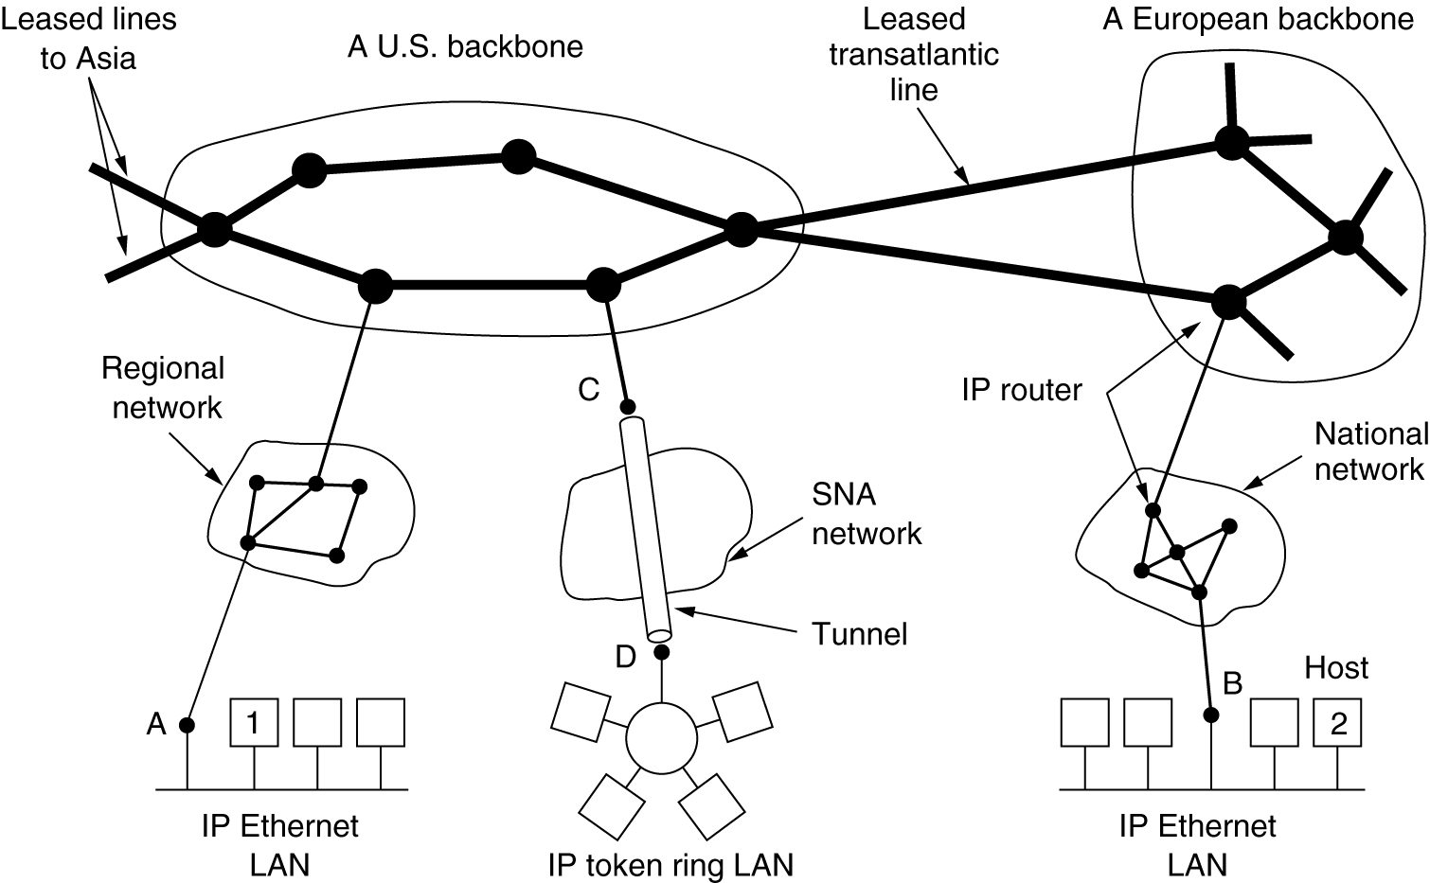
Collection of Subnetworks
The Internet is an interconnected collection of many networks.

Slide 21
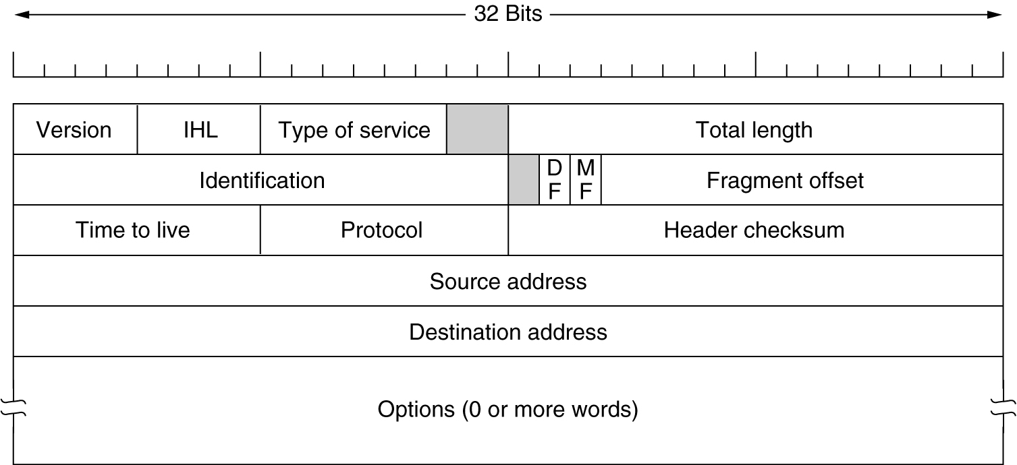
The IP Protocol
The IPv4 (Internet Protocol) header.

Slide 22
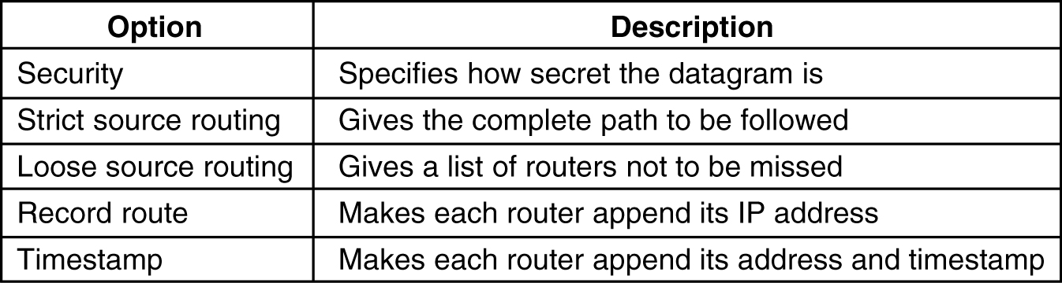
The IP Protocol (2)
5-54
Some of the IP options.

